Slide 1
Lecture 1

Slide 2
Java/JVM,
Java Applications,
Development Tools,
Sample Program,
Compilation

Slide 3
Java
Java is a popular general-purpose programming language and computing platform. It is fast, reliable, and secure. According to Oracle, the company that owns Java, Java runs on 3 billion devices worldwide.
Notes:
https://www.programiz.com/java-programming

Slide 4
Features of Java Programming Language
Java is platform independent
An object-oriented Language
Java is fast
Java is secure
Large Standard Library

Slide 5
Install Java

Slide 6
JVM
A Java virtual machine (JVM) is a virtual machine that enables a computer to run Java programs as well as programs written in other languages and compiled to Java bytecode.

Slide 7
The JVM is detailed by a specification that formally describes what is required of a JVM implementation.
Having a specification ensures interoperability of Java programs across different implementations so that program authors using the Java Development Kit (JDK) need not worry about idiosyncrasies of the underlying hardware platform.
Notes:
idiosyncrasies -- a mode of behaviour or way of thought peculiar to an individual

Slide 8
The JVM manages system memory and provides a portable execution environment for Java-based applications
The Java virtual machine is a program whose purpose is to execute other programs.
Notes:
https://www.javaworld.com/article/3272244/core-java/what-is-the-jvm-introducing-the-java-virtual-machine.html

Slide 9
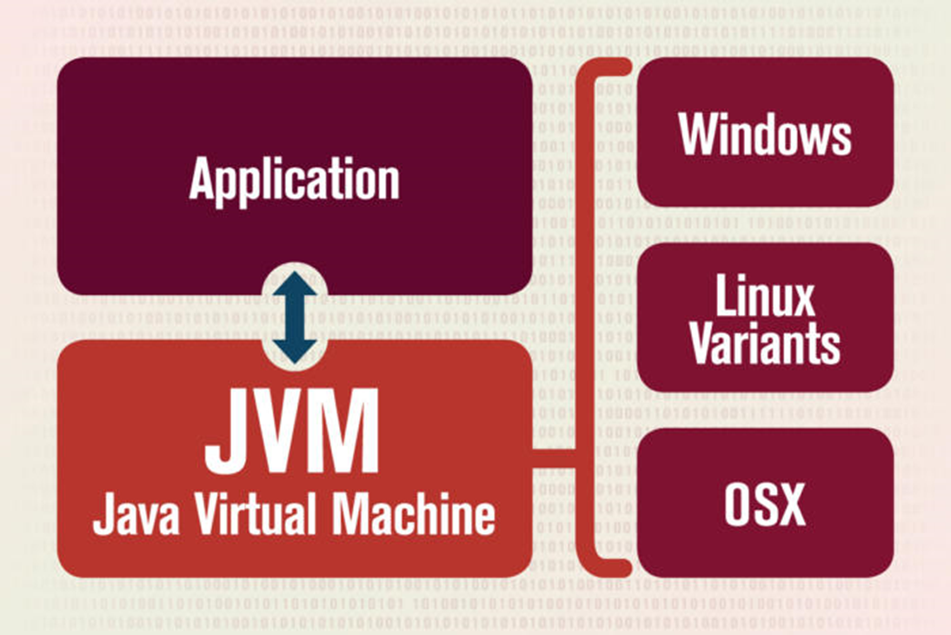

Slide 10
Garbage collection
Before Java, all program memory was managed by the programmer. In Java, program memory is managed by the JVM. The JVM manages memory through a process called garbage collection, which continuously identifies and eliminates unused memory in Java programs. Garbage collection happens inside a running JVM.

Slide 11
Java Applications
1. Desktop GUI Applications:
2. Mobile Applications:
3. Embedded Systems:
4. Web Applications:
5. Web Servers and Application Servers:
Enterprise Applications:
7. Scientific Applications:
Notes:
https://www.invensis.net/blog/it/applications-java-programming-language/

Slide 12
Development tools
JDK ( Java Development Kit) ...
Eclipse IDE. ...
NetBeans. ...
IntelliJ IDEA 13.1. ...
Oracle JDeveloper. ...
JUnit. ...
Apache ANT™ ...
JRat (Java Runtime Analysis Toolkit)
Notes:
https://dzone.com/articles/15-tools-make-life-easy-java

